Slide 1
John Lee Summer Project
Probability-based Surgical Guidance Tool for Balloon Angioplasty

Slide 2
Purpose
We would like to prototype a real-time guidance tool for balloon/stent placement
Inform surgeons of the best order of repair, as well as success odds.
Interesting
Notes:
Ideally, like to construct a real time guidance tool for stenting. Inform surgeons of best order of repair.

Slide 3
Project Goals/Steps
Given a 3D pulmonary model, construct a ROM (0D) segmentation model
Identify n vessels of stenosis on the 0D model for repair.
Train a feed-forward neural network using 0D simulations, to capture the changes in pressure/flow corresponding to radius increase in vessels.
Determine some probability distribution for repair, and compute marginal/conditional probabilities to answer relevant clinical questions
Notes:
Just Read.

Slide 4
Goal 1
Construct ROM from 3D model
Notes:
Organize in terms of goals

Slide 5
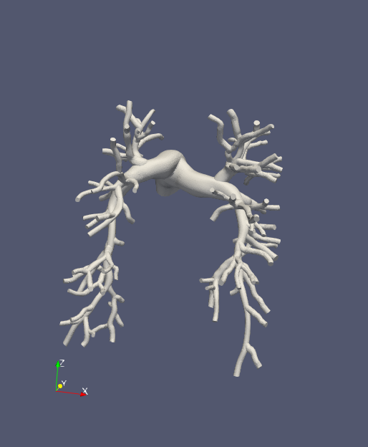
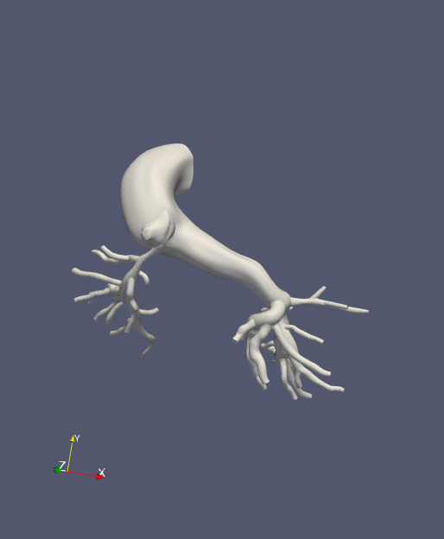
Models
Healthy Models
Artificially stenose models
Helpful to know actual healthy values for uncertainty quantification later
Stenosis Models
Have actual stenosis which must be identified
Should have previously computed RCR boundary conditions
Currently 5 total working models
3 Healthy
2 Stenosis
0080_0001 (Healthy)
0118_1000 (Alagille)
Notes:
Model Issues
- Some models are not finely meshed/blended well and have issues constructing centerlines
- Ingrid’s models are in an older version of simvascular and must be reconstructed.

Slide 6
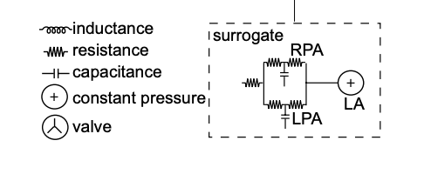
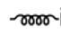
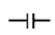
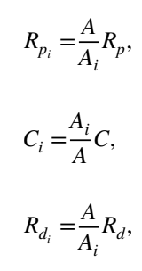
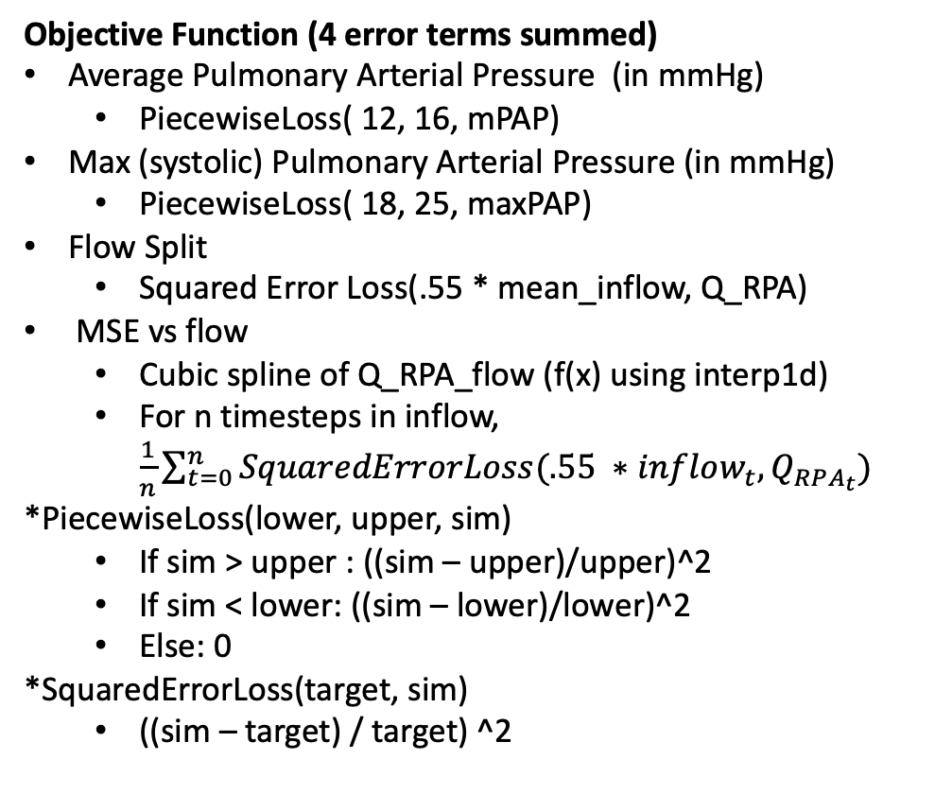
Healthy Models/ BC tuning
Objective Function (4 error terms summed)
Average Pulmonary Arterial Pressure (in mmHg)
PiecewiseLoss( 12, 16, mPAP)
Max (systolic) Pulmonary Arterial Pressure (in mmHg)
PiecewiseLoss( 18, 25, maxPAP)
Flow Split
Squared Error Loss(.55 * mean_inflow, Q_RPA)
MSE vs flow
Cubic spline of Q_RPA_flow (f(x) using interp1d)
For n timesteps in inflow, $\frac{1}{n}\sum_{t=0}^{n}{SquaredErrorLoss(.55 ∗inflow_{t}, Q_{RPA_{t}})}$
*PiecewiseLoss(lower, upper, sim)
If sim > upper : ((sim – upper)/upper)^2
If sim < lower: ((sim – lower)/lower)^2
Else: 0
*SquaredErrorLoss(target, sim)
((sim – target) / target) ^2
Yang et. al. 2019 Surrogate model (Modified)
MPA
Constant RCL values for MPA
C is computing assuming linear eh_r of 1.2e6 dynes/cm^2
RPA Tree and LPA Tree precomputed resistances using resistances in parallel and series
Tunable RCR boundary conditions for LPA and RPA, with constant capillary wedge pressure of 7 mmHg
Split RCRS (Yang et. al. 2019)
Optimization
Ideal: obj func < .01 (1% error)
Typically set lower and let it early stop.
Early stop: patience (5 iter), patience_tolerance (1e-6)
Notes:
We take a modified surrogate tuning model used by Weiguang in 2019.
We use computed RCL values for the MPA, and represent the RPA/LPA trees by a resistance.
This resistance is computed using resistances in series and parallel. There is a slight issue where these resistances alone only correspond to about .15 mmHg drop in resistance, as opposed to an excepted 3 – 5 mmHg for a healthy model. Although neglected at first, we plan to add the stenosis coefficients too (which should increase the drop).
For actual tunable parameters, we set RCR boundary conditions for the RPA and LPA respectfully with a target capillary wedge pressure of 7
Our objective function is on the right, tuning for average PAP, systolic PAP, flow split and, overall flow split shape
Ideally, our target is < 1% error, but we typically set it lower and just let it early stop since tuning is not expensive.
We split our RPA/LPA rcrs using the formulas below.
Run our own 3D simulations

Slide 7
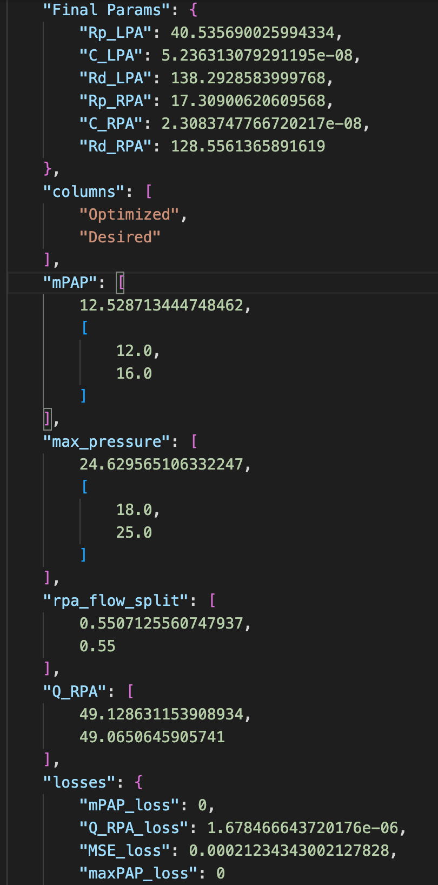
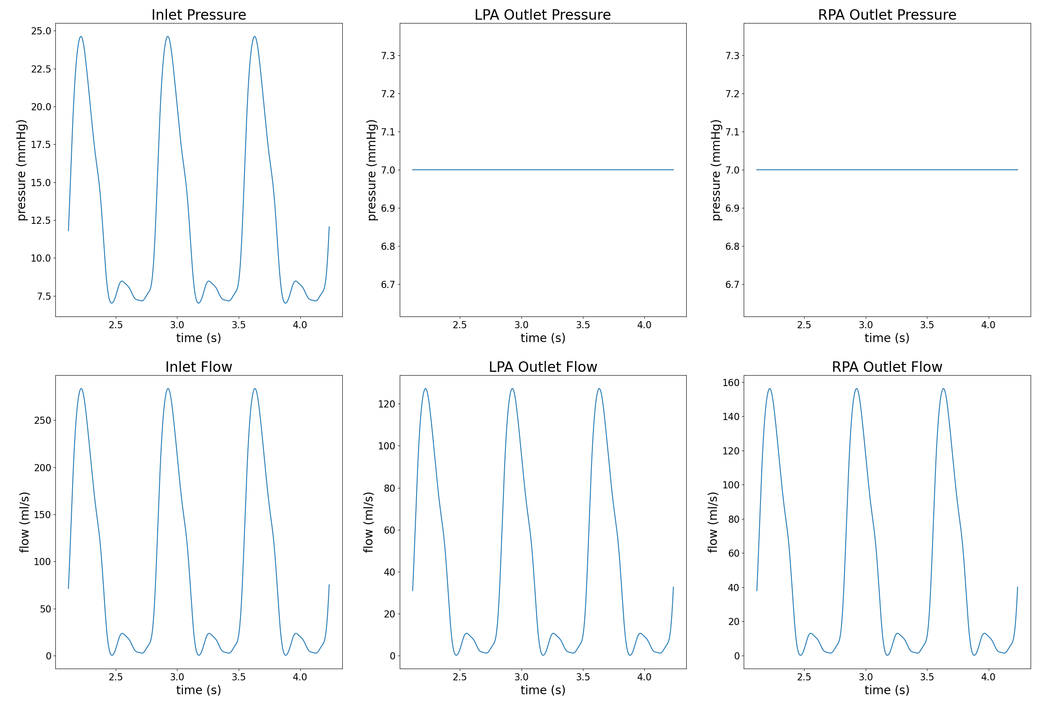
Optimization Results/Sanity Checks (ex. 0080_0001)

Slide 8
Stenosis Models BC
Only use models where an RCRT.dat file is provided for 3D simulations
Must be mapped back to 0D style where face/cap names are also included in the file
Comes from both VMR & Ingrid’s previous models
Notes:
For stenosis models, since no inlet pressure information was given, we convert RCRs prepared for 3D simulations for use in 0D.

Slide 9
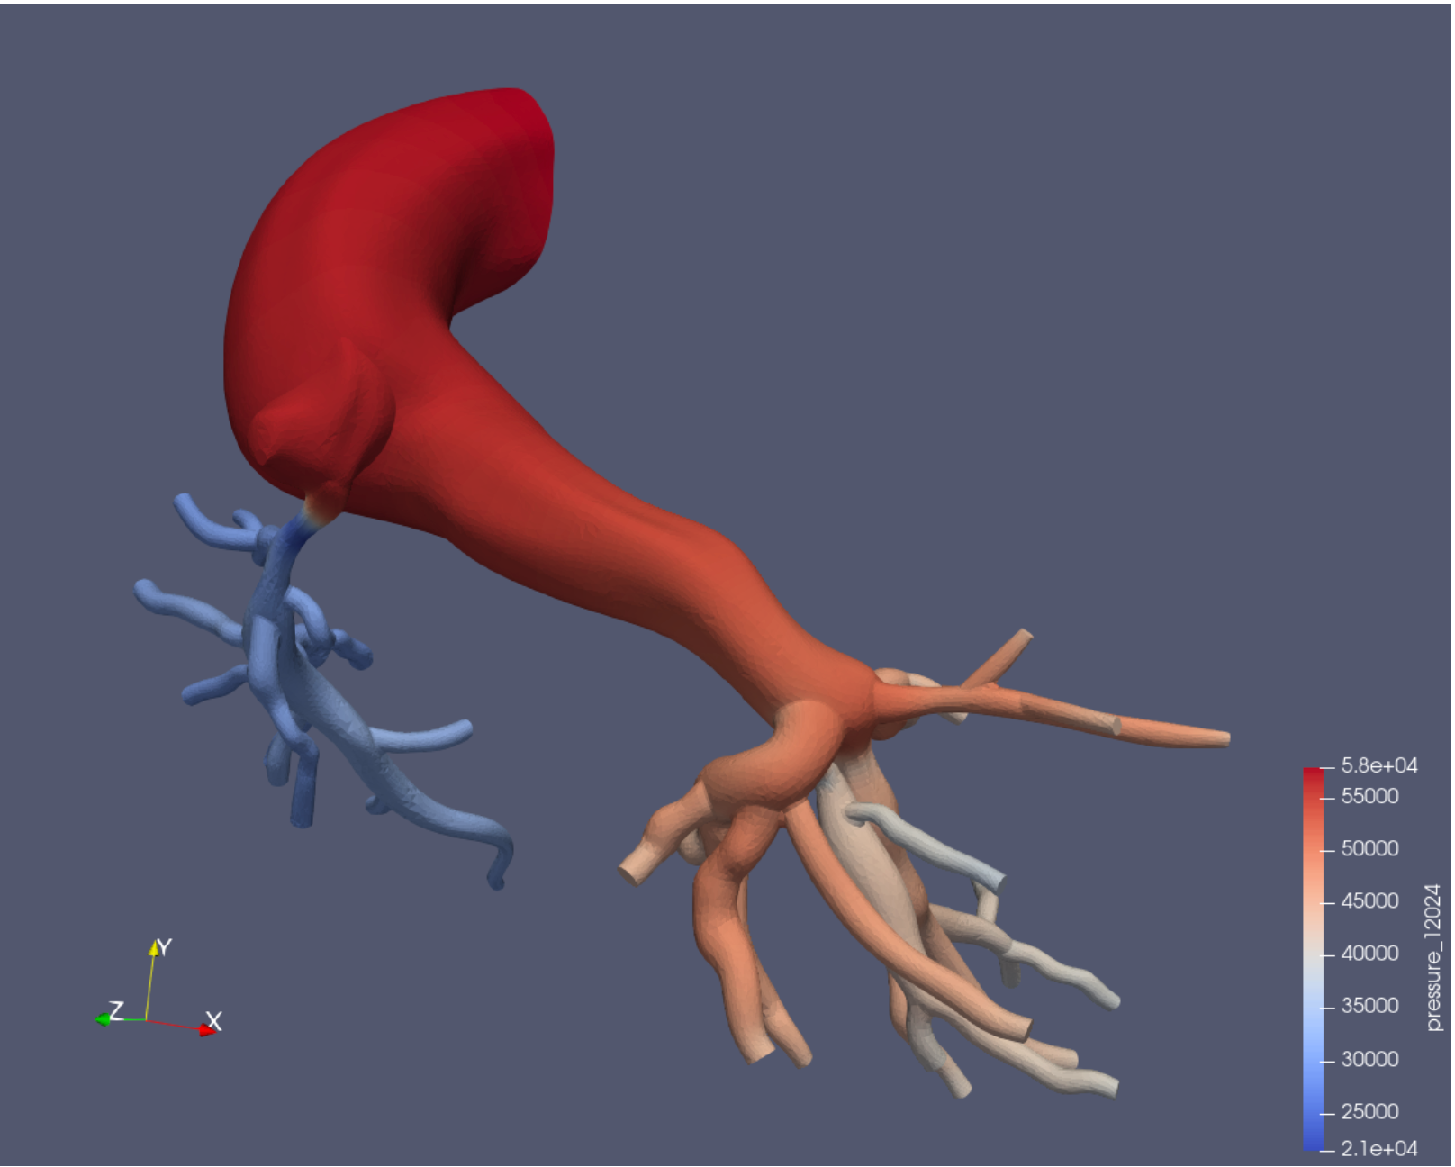
Junction Stenosis Problem
Originally identified because of model 0118_1000 (left) where most of the stenosis was identified
However, it is also the case that the significant number of junctions in pulmonary models induced a higher error in 0D simulations than other vasculatures.
Noticed that 0D simulations fail to capture the pressure drop across the tree.

Slide 10
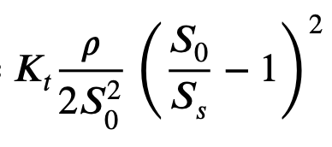
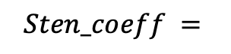
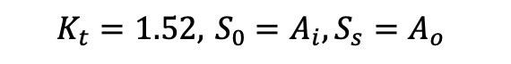
Potential Solutions
$$Sten_coeff =$$
Junction Coefficients (Implemented)
Use vessel stenosis coefficient formula
Take inlet area of junction, and one outlet area, adding coeff to downstream vessel
More extensive/ML Junction solution
Opened Issue on GitHub
3D-optimization
Tune 0D RCL’s to match pressure drop in a 3D model
Project-specific solution
$$K_{t}=1.52, { S}_{0 }=A_{i}, S_{s}=A_{o}$$

Slide 11
Preliminary Results

Slide 12
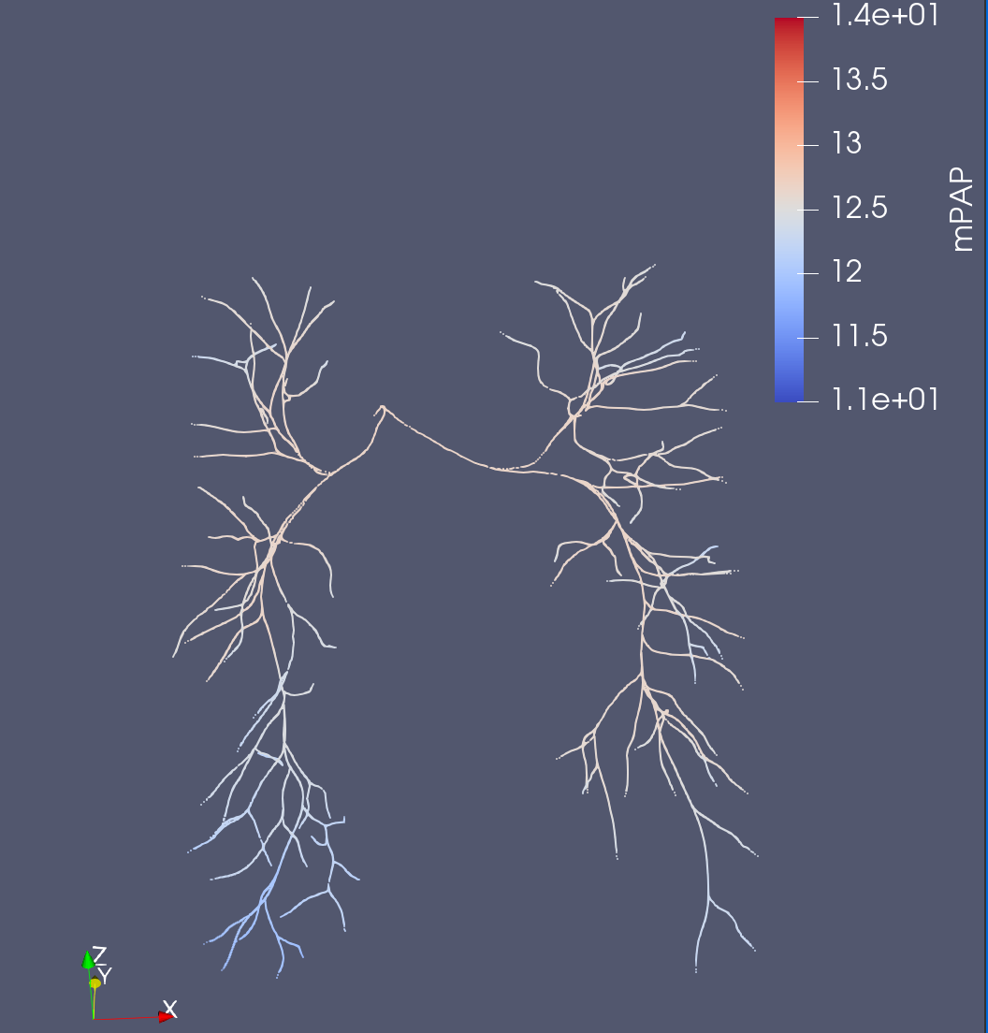
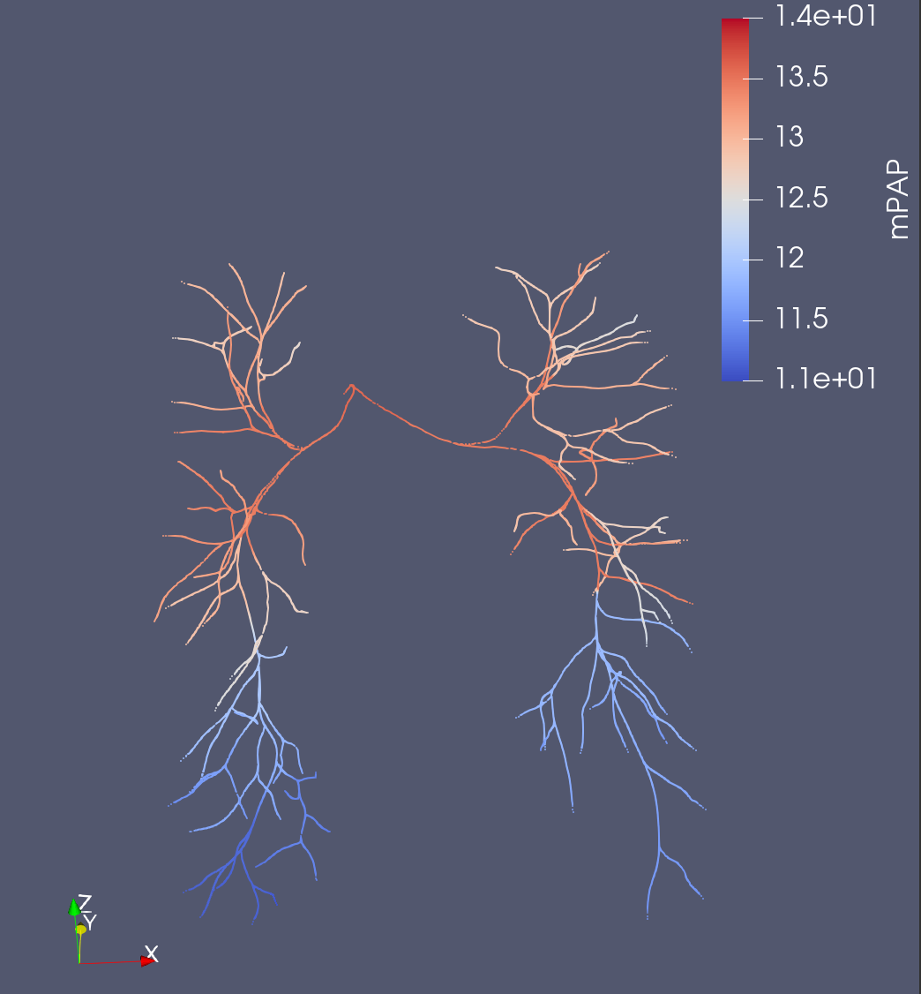
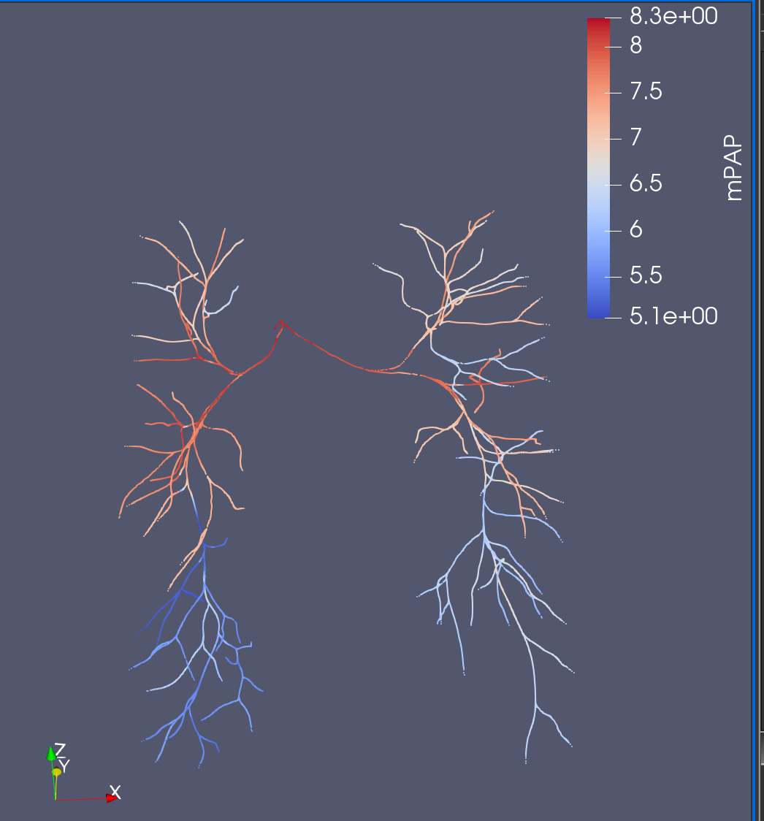
0080_0001 (meanPAP)
Original Solver
Junction Coefficient Solver
3D
JC Solver captures relative pressure drop across tree better
*BCs were not retuned to account for increased resistance in JC Solver (3D results is not a perfect comparison)
Not to scale

Slide 13
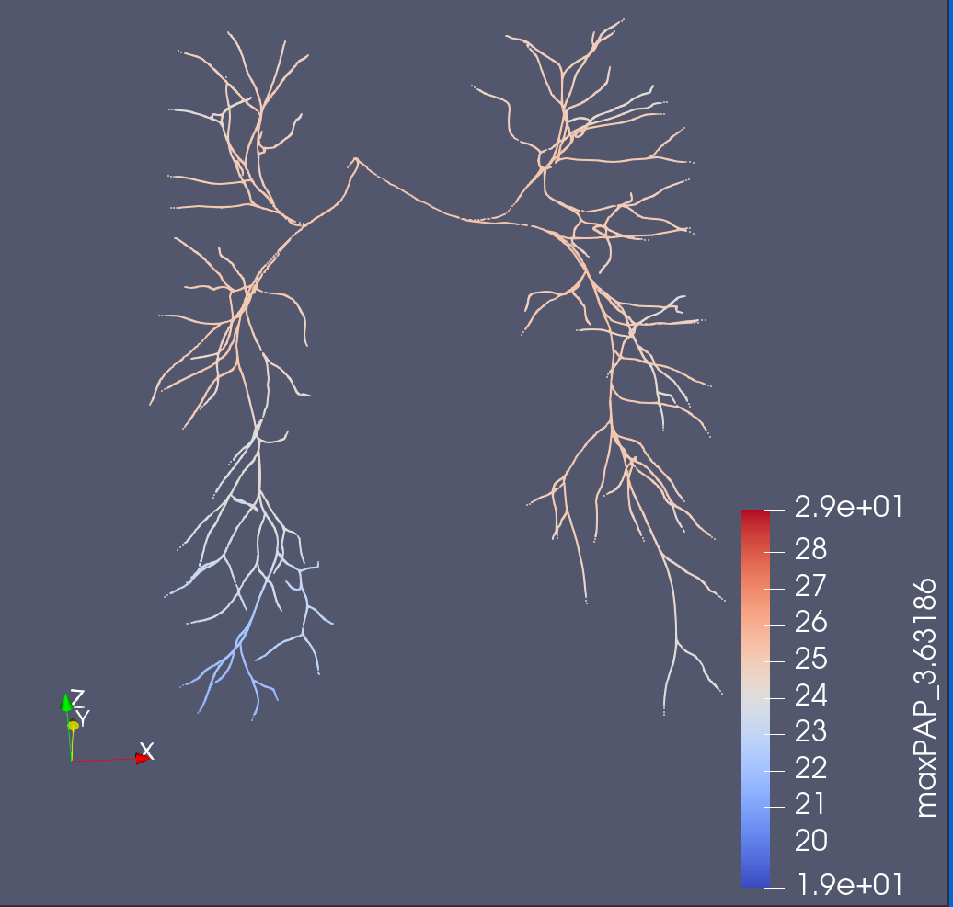
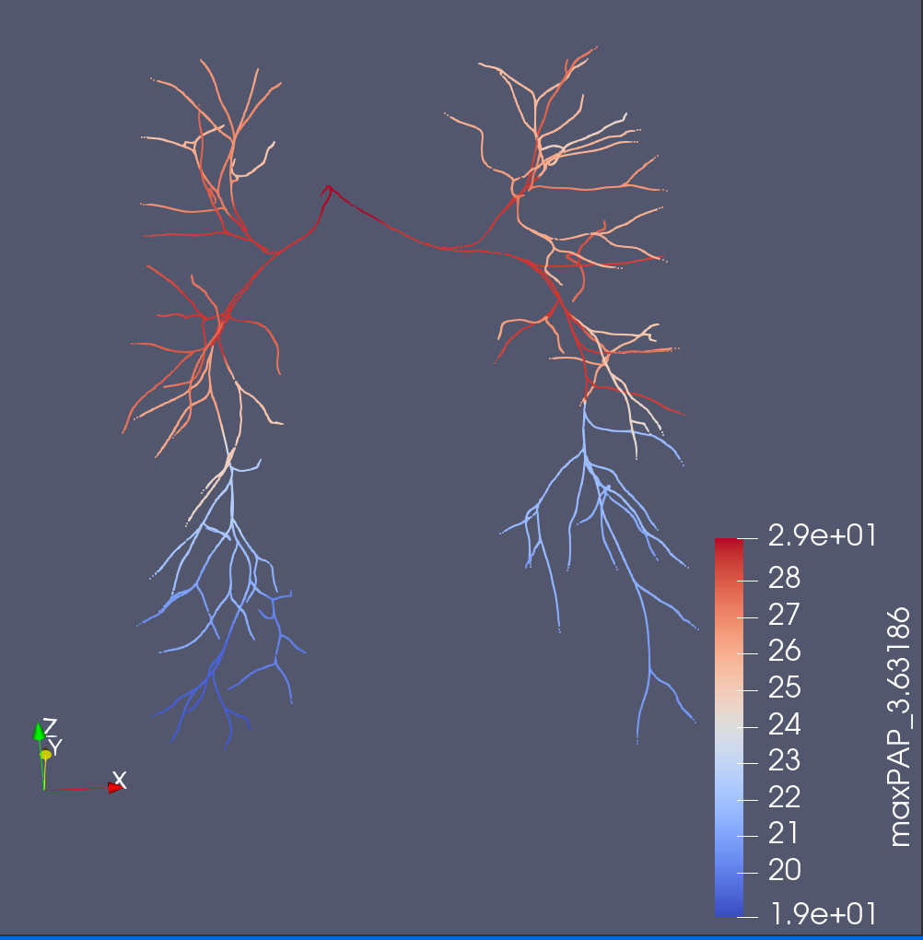
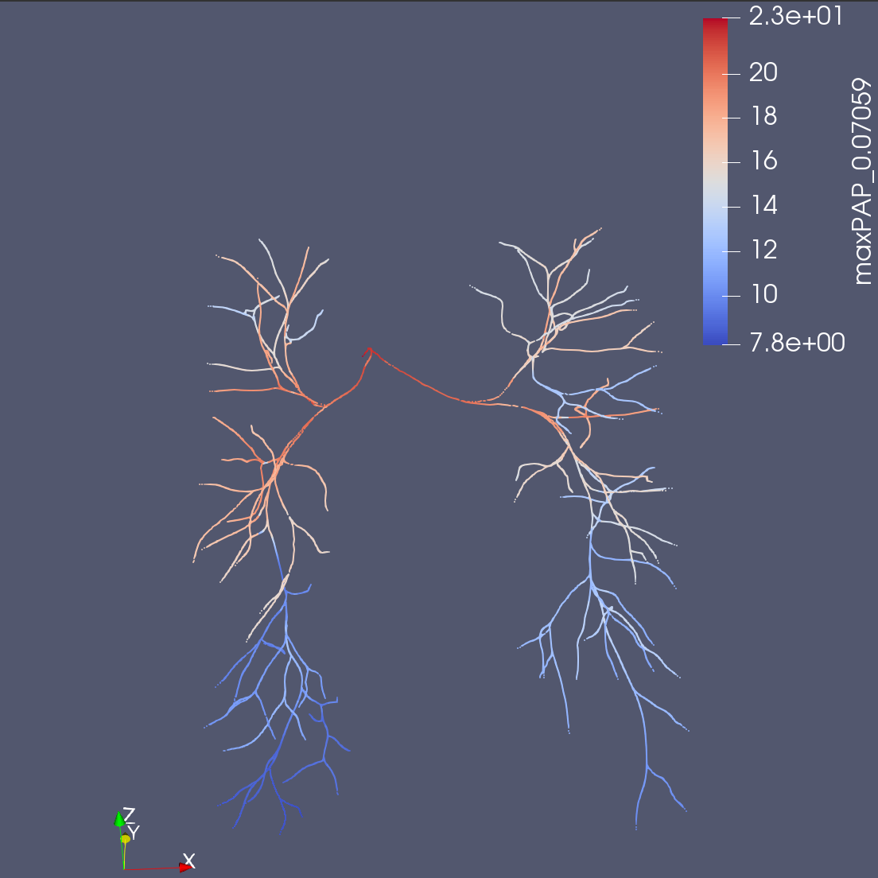
0080_0001 (maxPAP)
Original Solver
Junction Coefficient Solver
3D
Not to scale

Slide 14
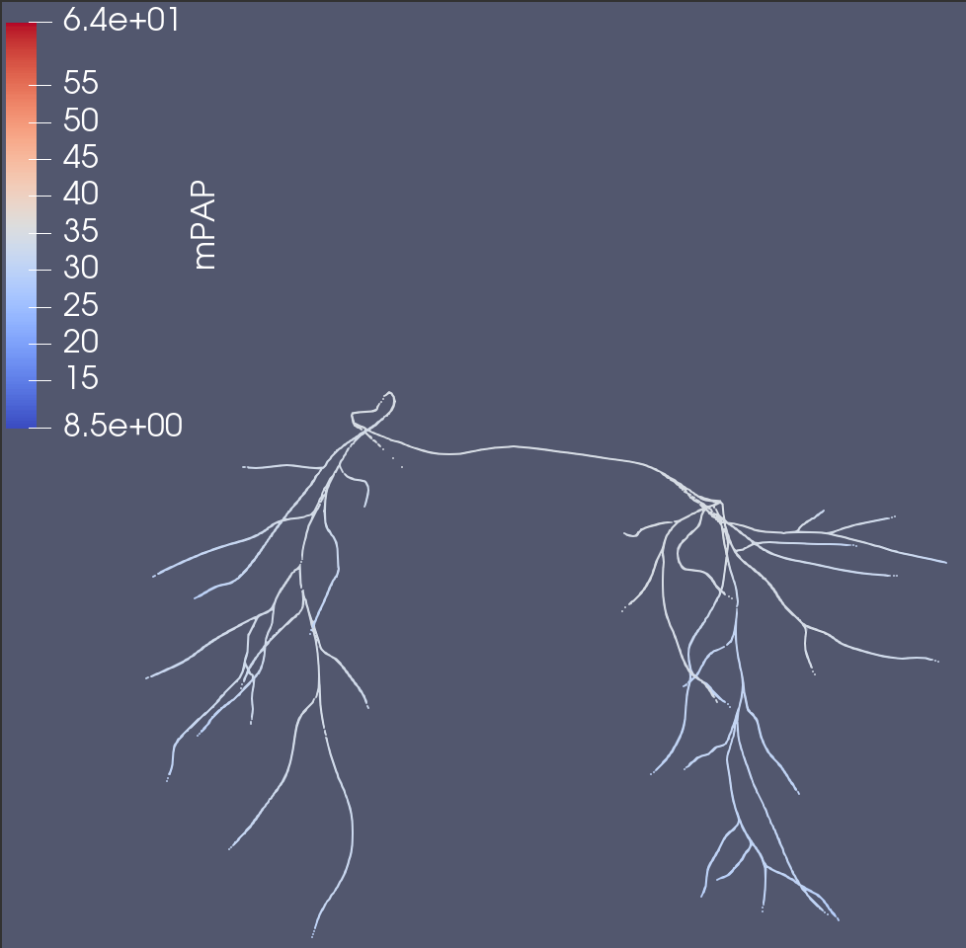
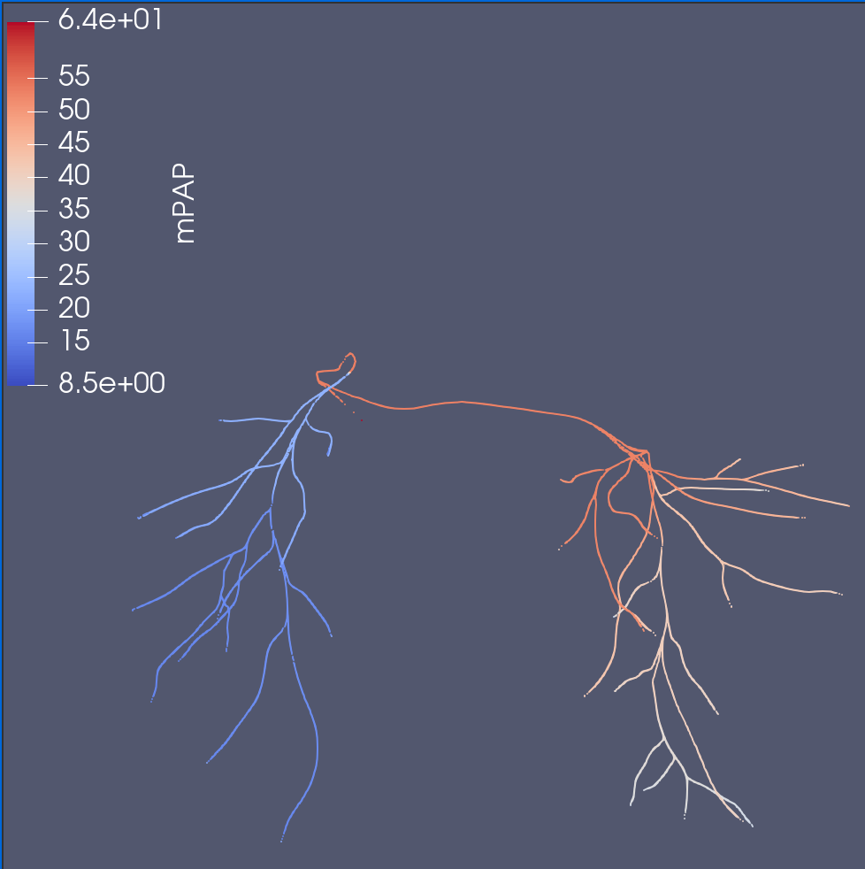
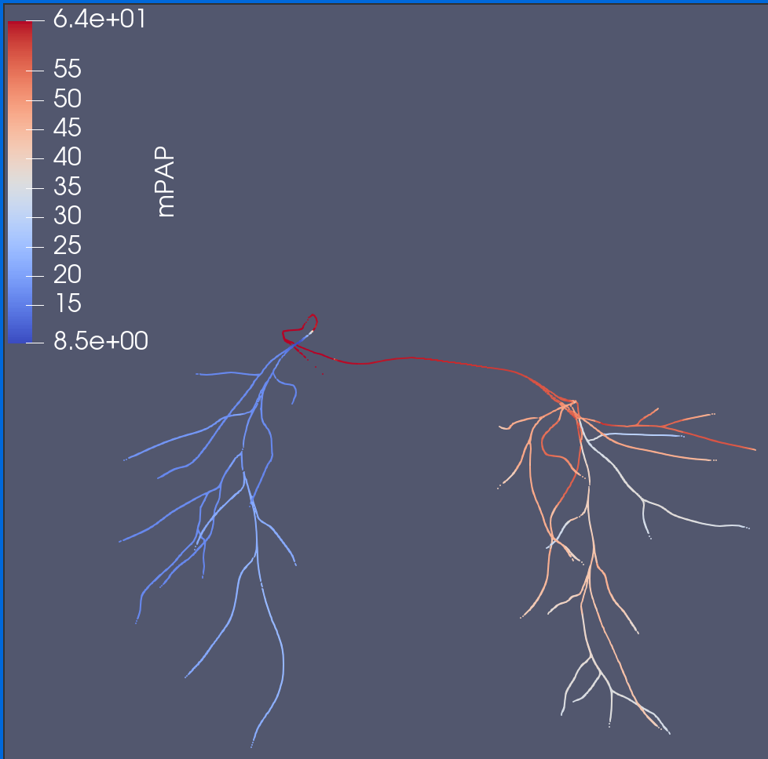
0118_1000 (meanPAP)
Original Solver
Junction Coefficient Solver
3D
JS Solver captures pressure distribution/drop better

Slide 15
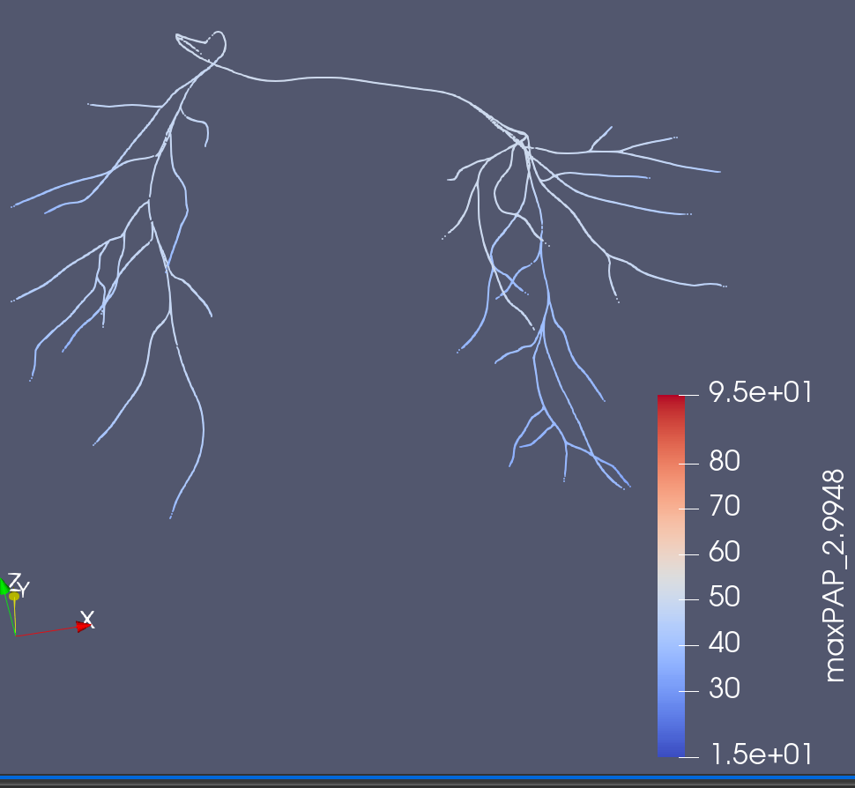
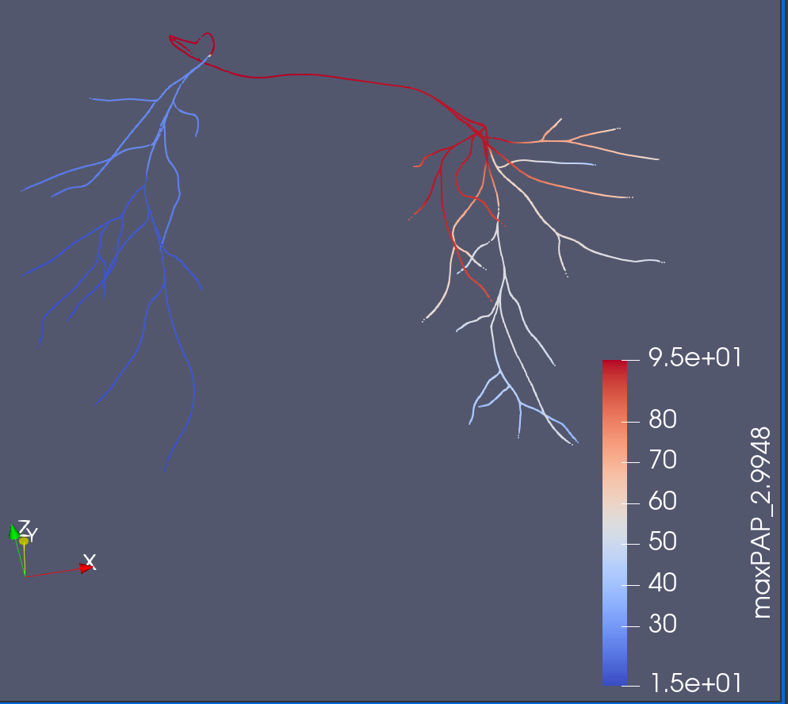
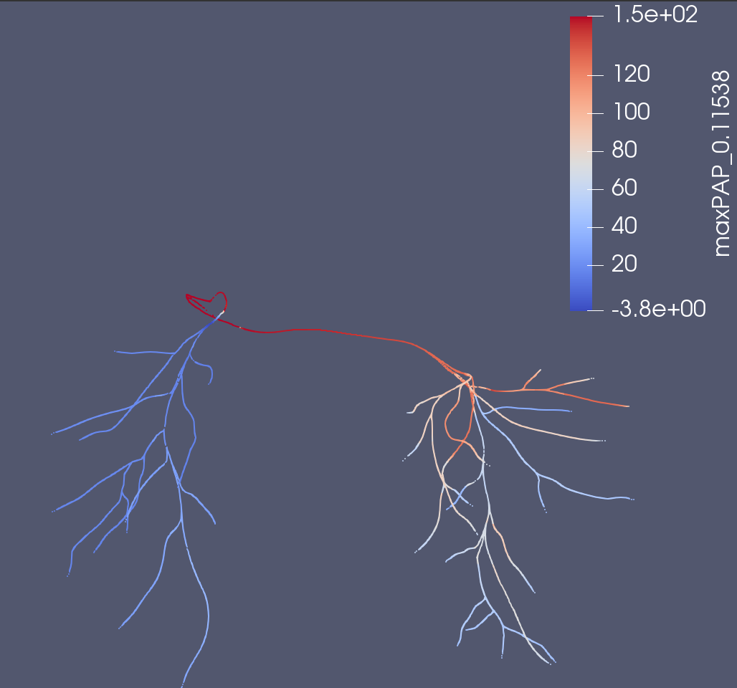
0118_1000 (maxPAP)
Original Solver
Junction Coefficient Solver
3D
Although JS Solver is unable to fully capture systole, it is far closer.
Not to scale

Slide 16
Quantitative Metrics
How should I approach the error terms here?
How can I quantify a better pressure drop?
How can I quantify a better split of pressure.

Slide 17
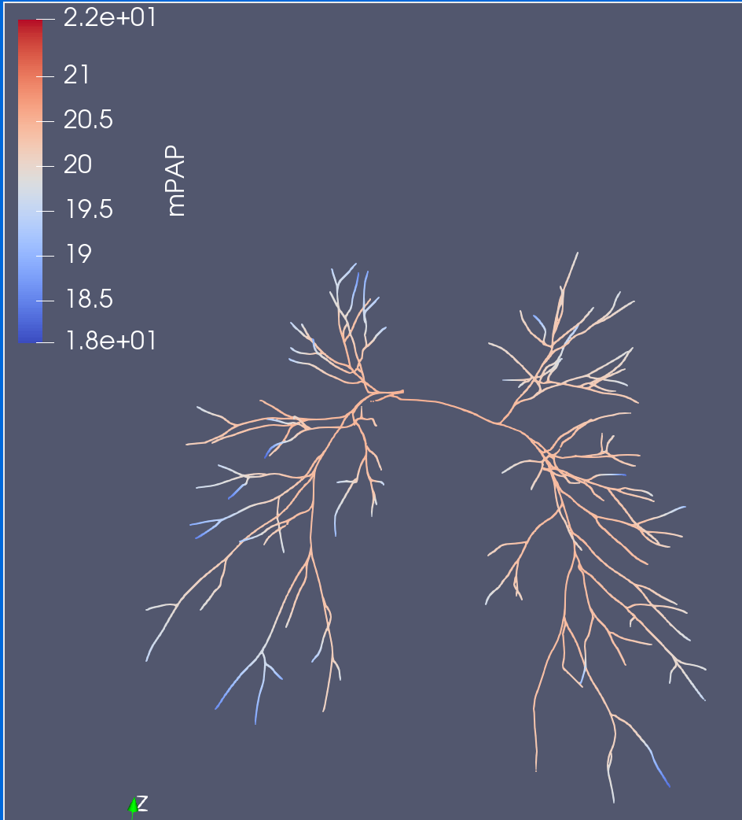
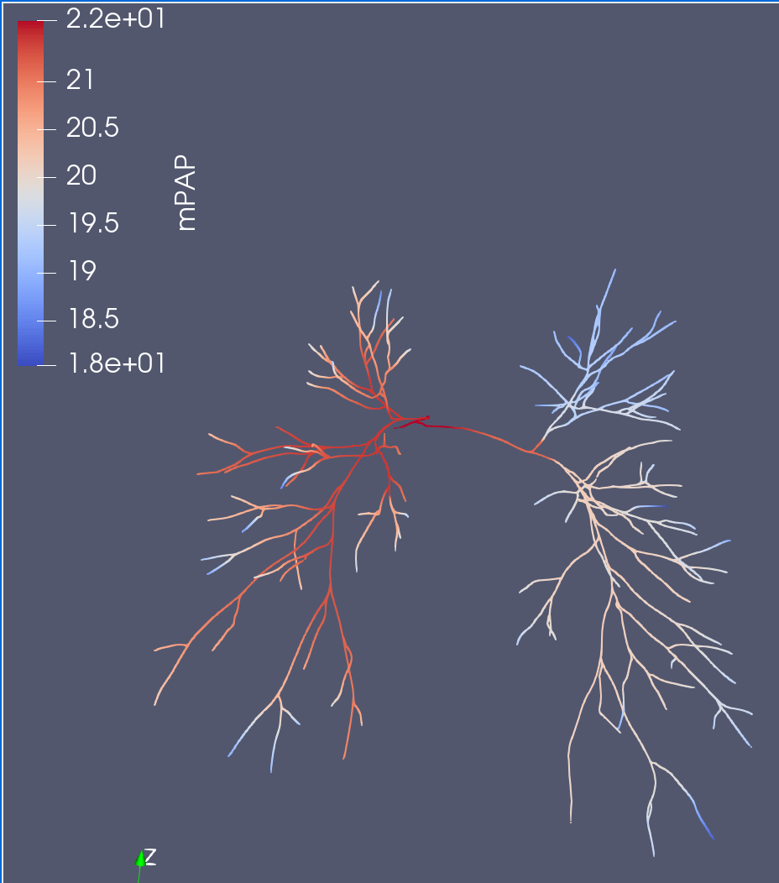
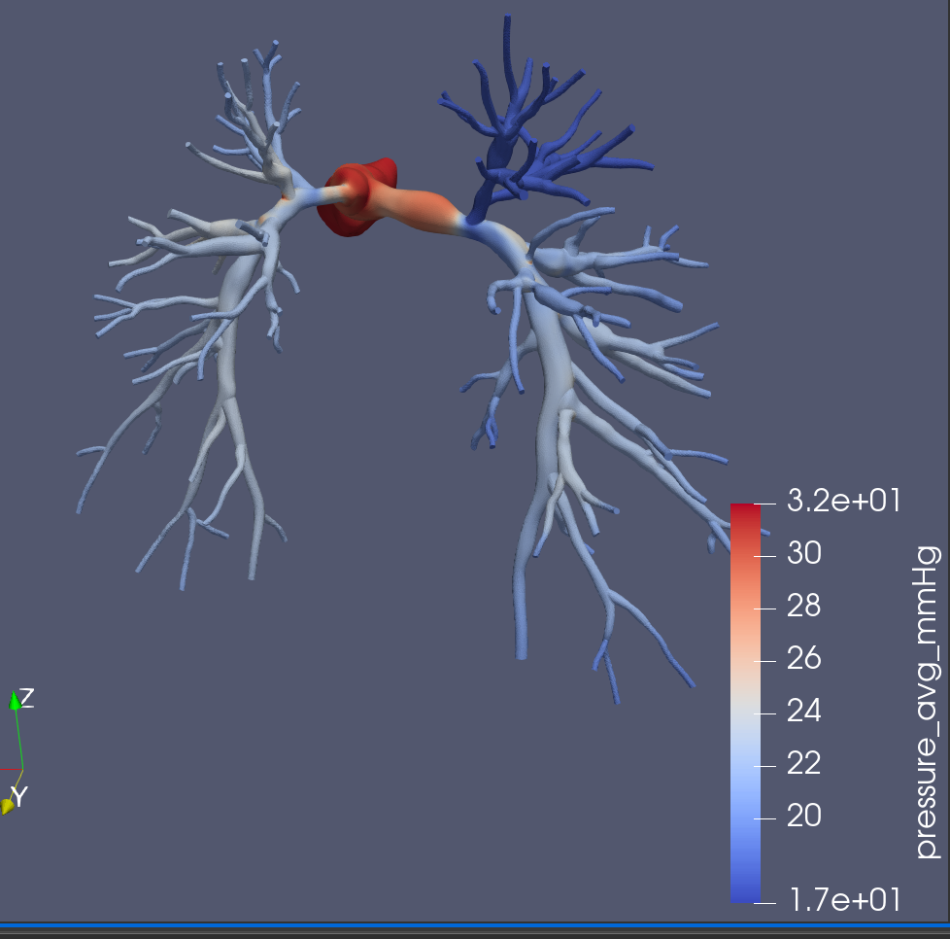
SU0238 (mPAP)
Original Solver
Junction Coefficient Solver
3D
Are cases where JC Solver is also insufficient.
Suspect either insufficient number of vessels to capture rapid shrinkage in MPA radius (not a JC Solver problem)
Not to scale

Slide 18
Goal 1 – Next Steps
Tuning BC w.r.t Junction Coefficient Solver and running 3D simulations for healthy models.
Making more accurate comparisons.
Correcting more healthy models to expand dataset.
More quantitative results (including flow)
Refine coefficient formula slightly, perhaps through some regression.

Slide 19
Goal 2
Selecting n stenosis points.

Slide 20
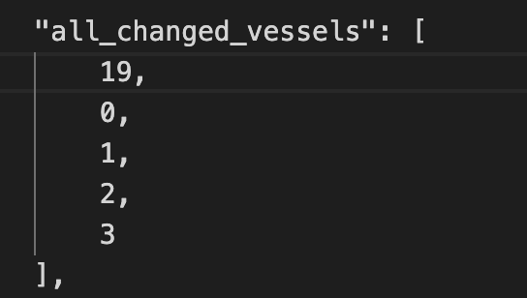
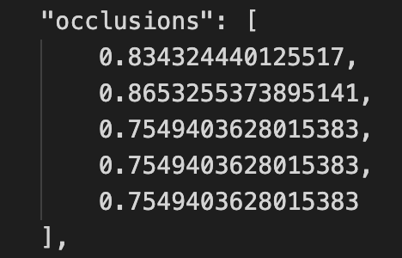
Artificial Stenosis – Healthy Models
Construct a Branch Tree of the PA w/ generations
Gen 0: MPA, Gen 1: RPA & LPA, …
Using the Branch tree, determine n possible branches to stenose in the first g generations
Use a y = poisson(𝜆 = 2*g) to determine how many locations exactly to stenose (this is subject to change)
Uniformly select y vessels from all n locations and give it an occlusion value from .75 - .9.
Make changes to R, C, L corresponding to occlusion change in the branch
Make changes to algorithm to avoid probability based artificial stenosis
Sample Stenosis only stenoses MPA (0), LPA (1,2,3), RPA (19).
Notes:
We are considering making a change, so rather than probability based, we will try to match stenosis according to one of Ingrid’s models and observe the change.

Slide 21
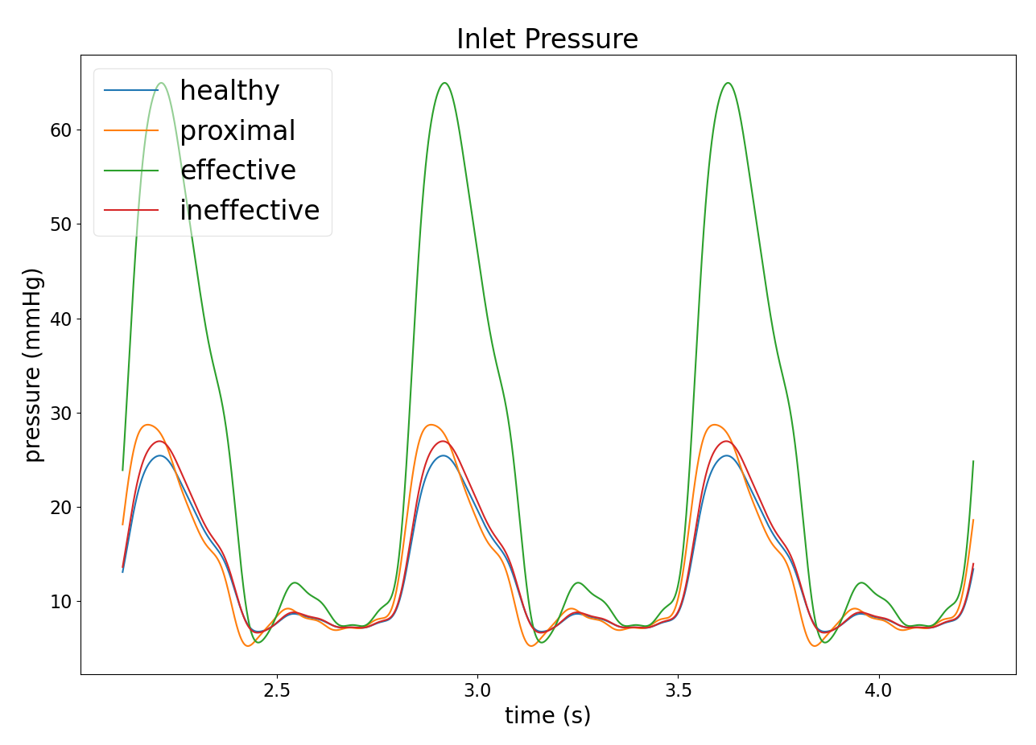
Artificial Stenosis (original)
Healthy (no change)
Proximal
Surprising that the effect is so small
75% occlusion on all vessels
Ineffective/Effective
Two different randomly generated stenosis sample
Highly dependent on total length of stenosis
Concerns that when stenosis/occlusion levels are reduced to more reasonable degrees, the effect may be negligible
Model 0080_0001

Slide 22
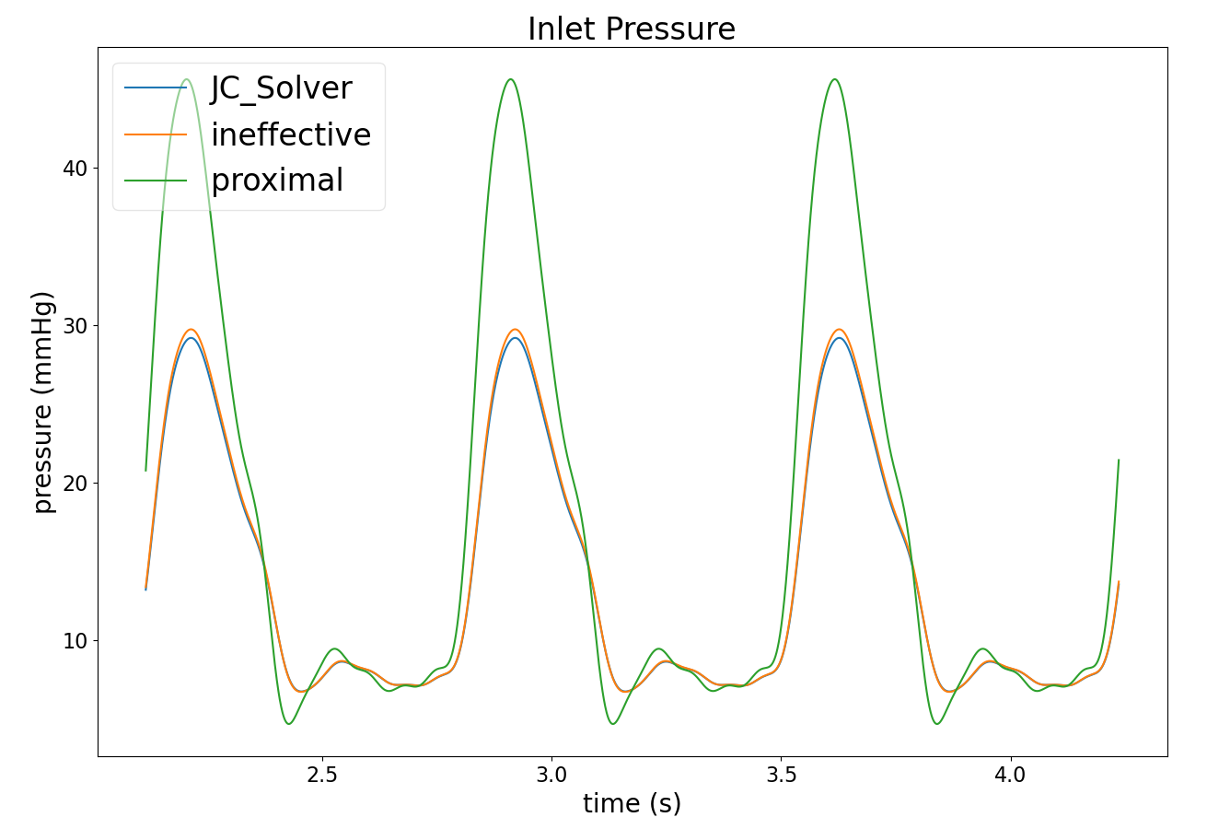
Artificial Stenosis (JCSolver)
JCSolver
Base JC Solver waveforms
Ineffective
Got unlucky and only stenosed 5 vessels.
Proximal
Much more significant effect, as expected of stenosing proximal
75% occlusion on all vessels
Model 0080_0001

Slide 23
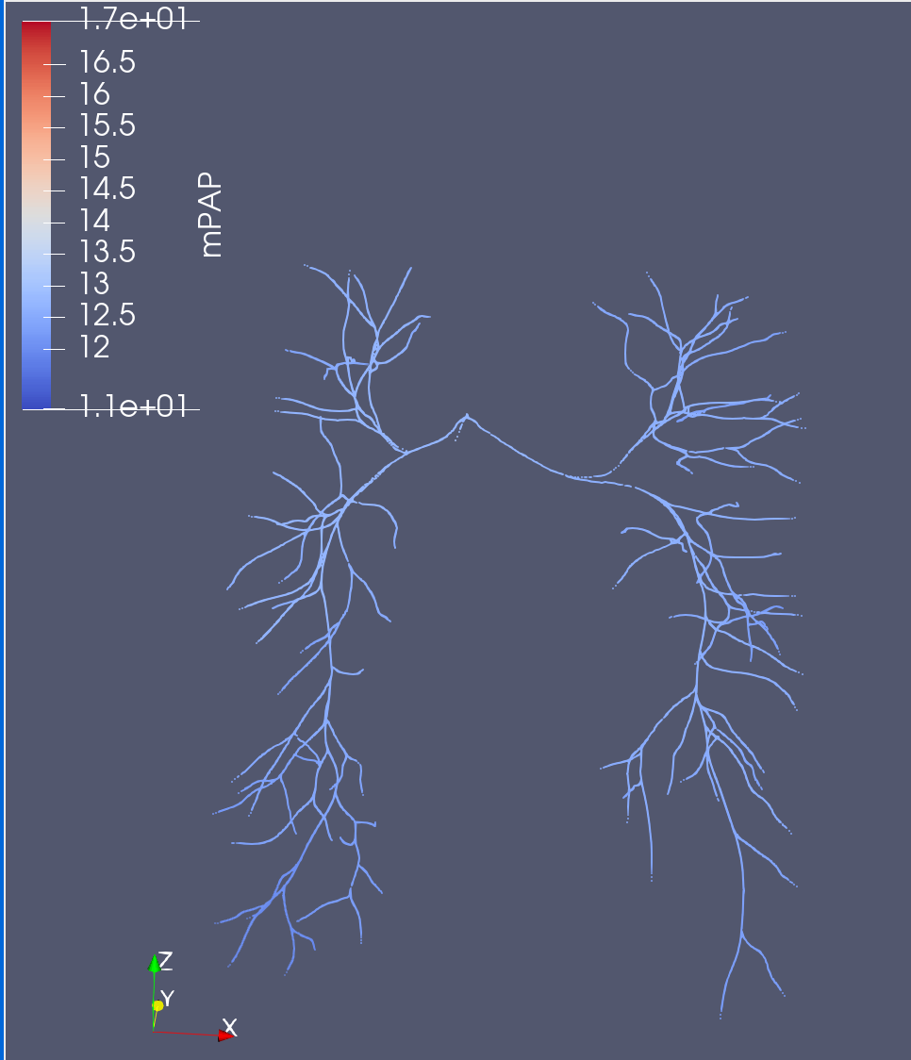
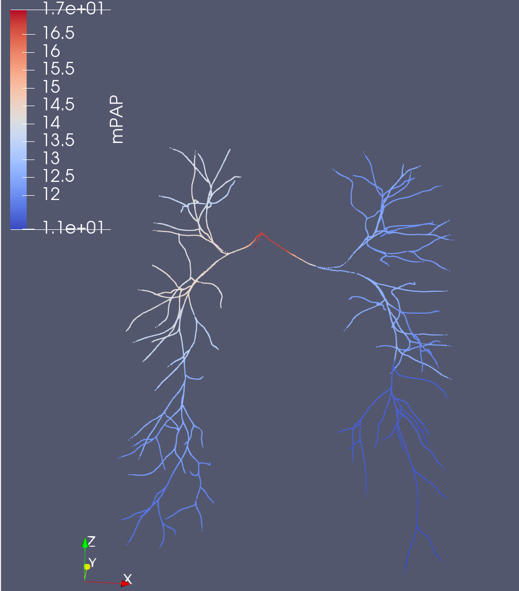
Comparing Proximal
Original
JC Solver

Slide 24
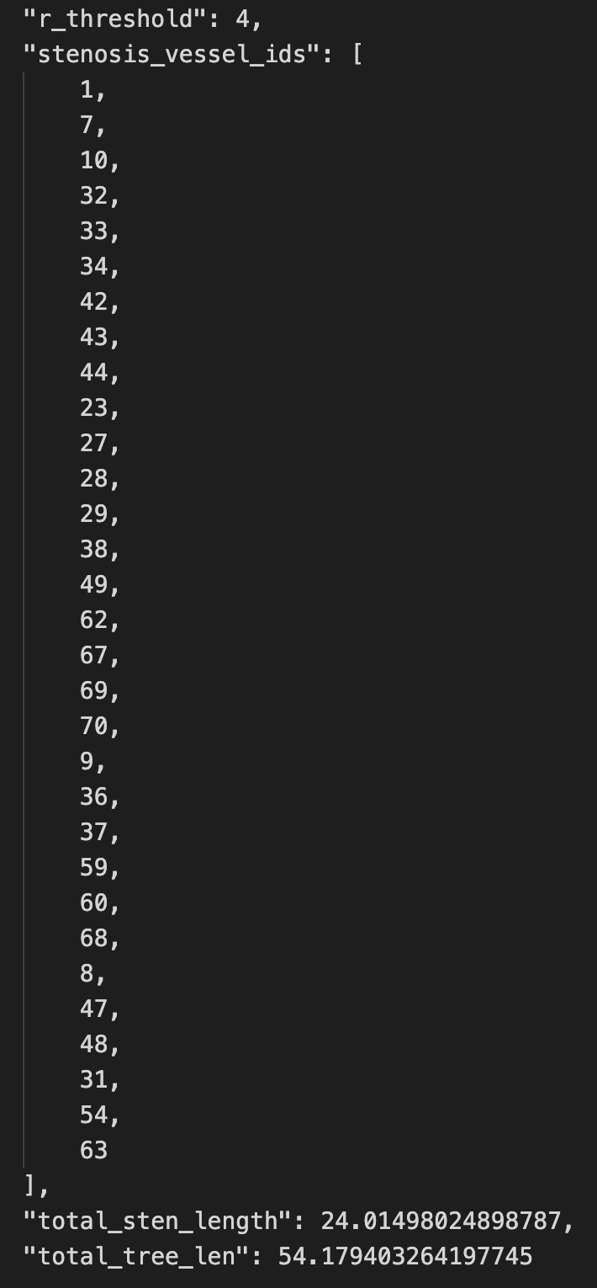
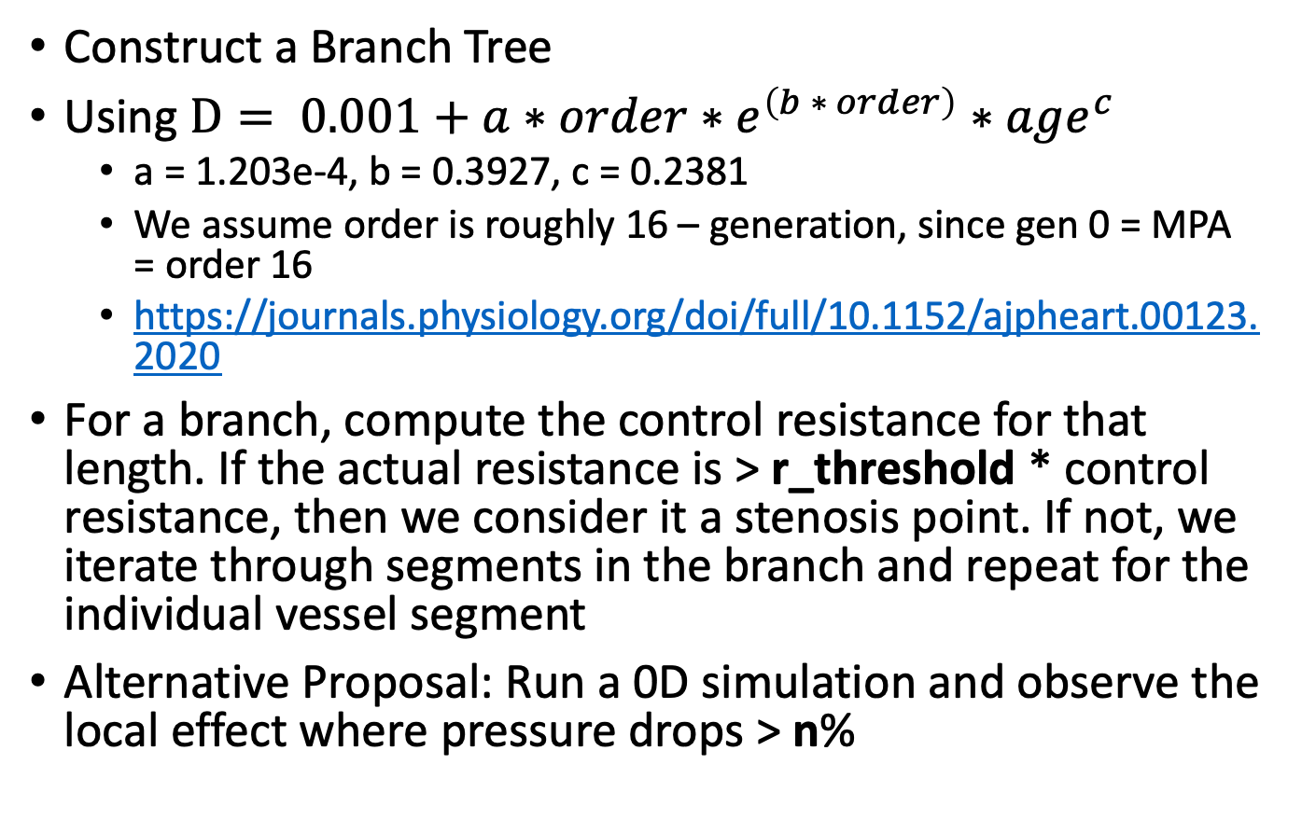
Identifying Stenosis
Construct a Branch Tree
Using $D= 0.001+a∗order∗e^{\left(b ∗ order\right)}∗age^{c}$
a = 1.203e-4, b = 0.3927, c = 0.2381
We assume order is roughly 16 – generation, since gen 0 = MPA = order 16
https://journals.physiology.org/doi/full/10.1152/ajpheart.00123.2020
For a branch, compute the control resistance for that length. If the actual resistance is > r_threshold * control resistance, then we consider it a stenosis point. If not, we iterate through segments in the branch and repeat for the individual vessel segment
Alternative Proposal: Run a 0D simulation and observe the local effect where pressure drops > n%

Slide 25
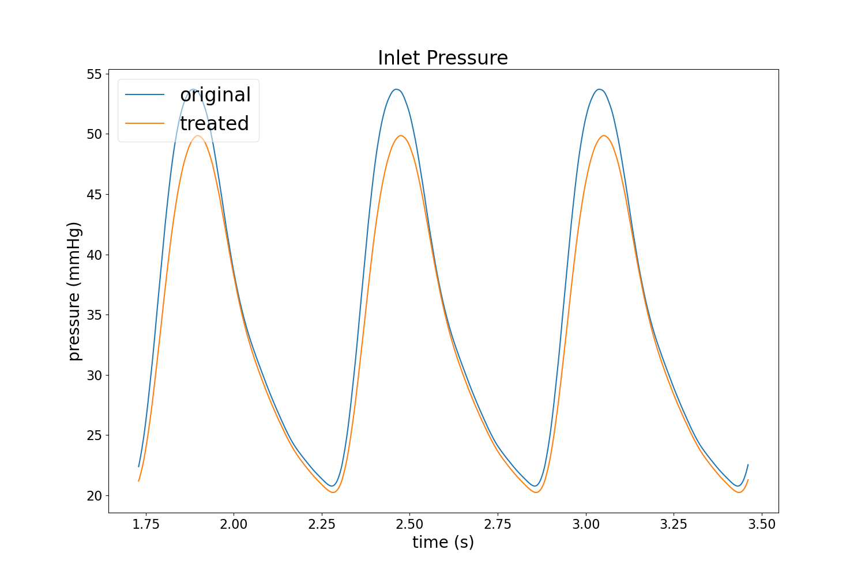
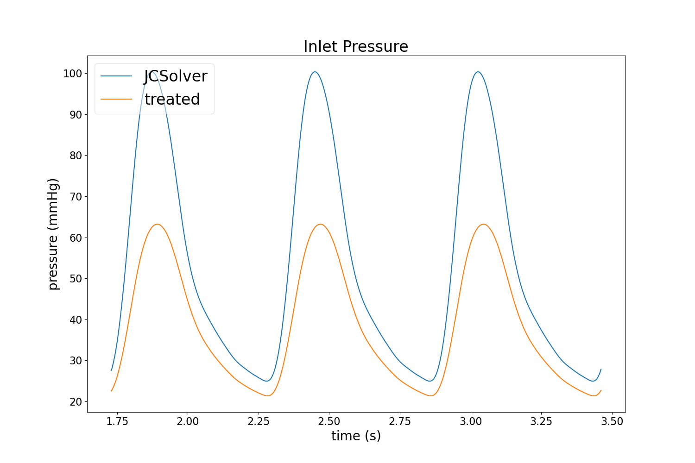
Original vs. JC effect on Treatment
Original
JCSolver
* Using same BC, but no way to tune right now.

Slide 26
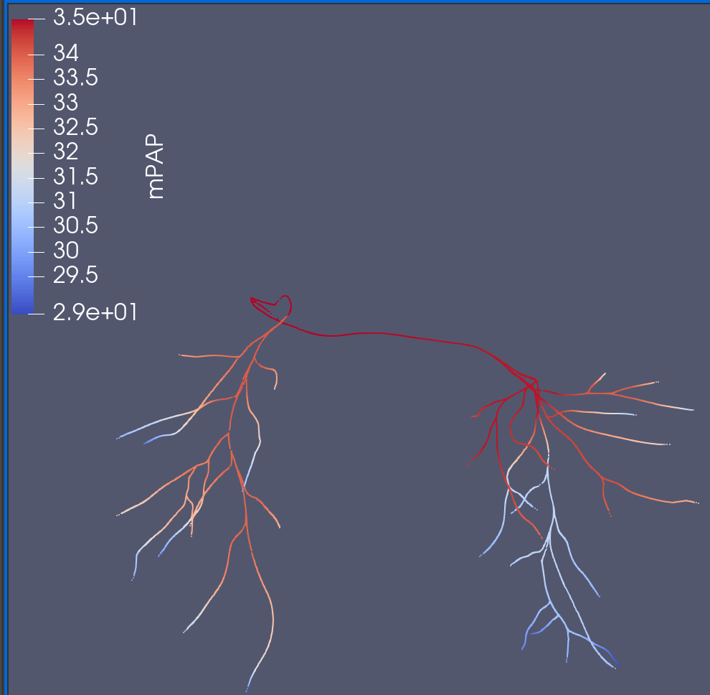
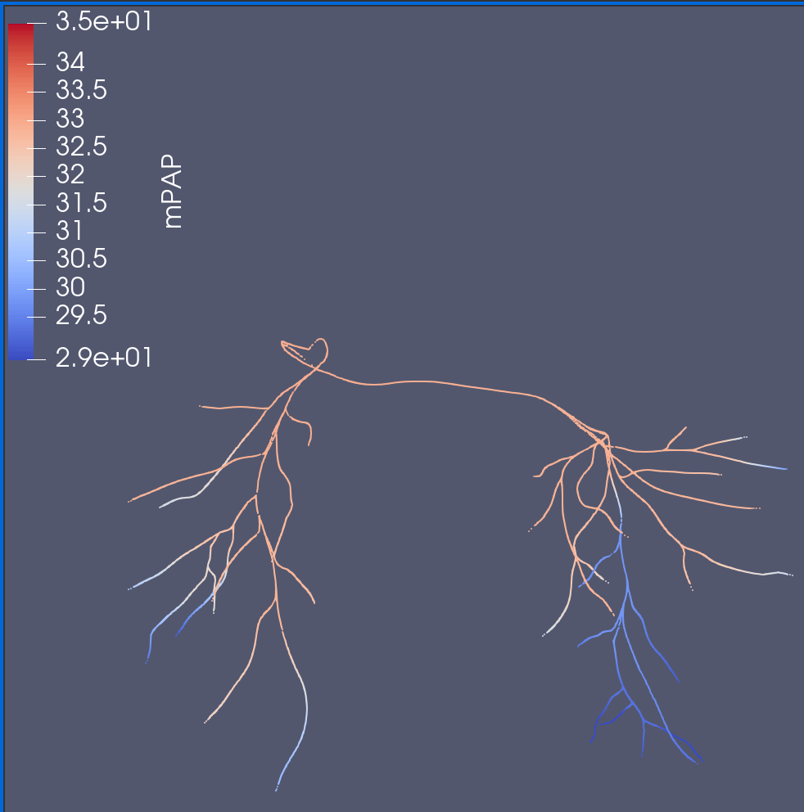
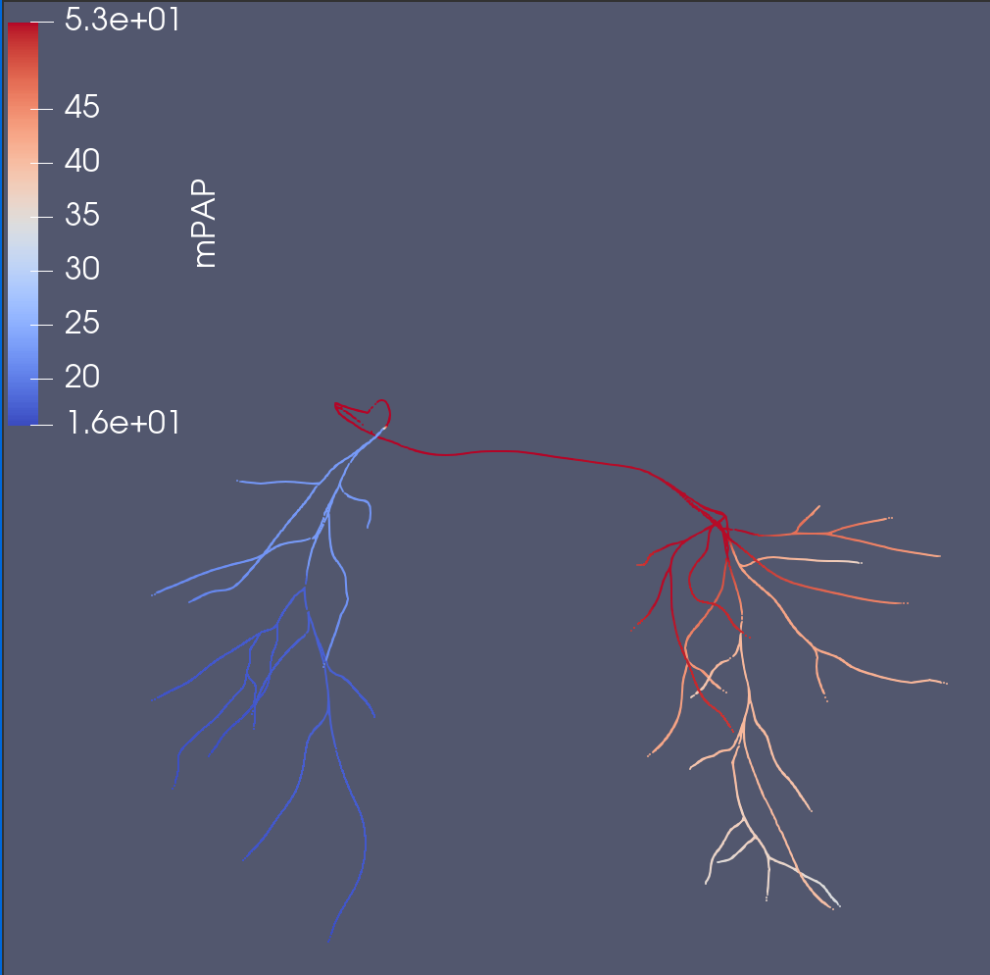
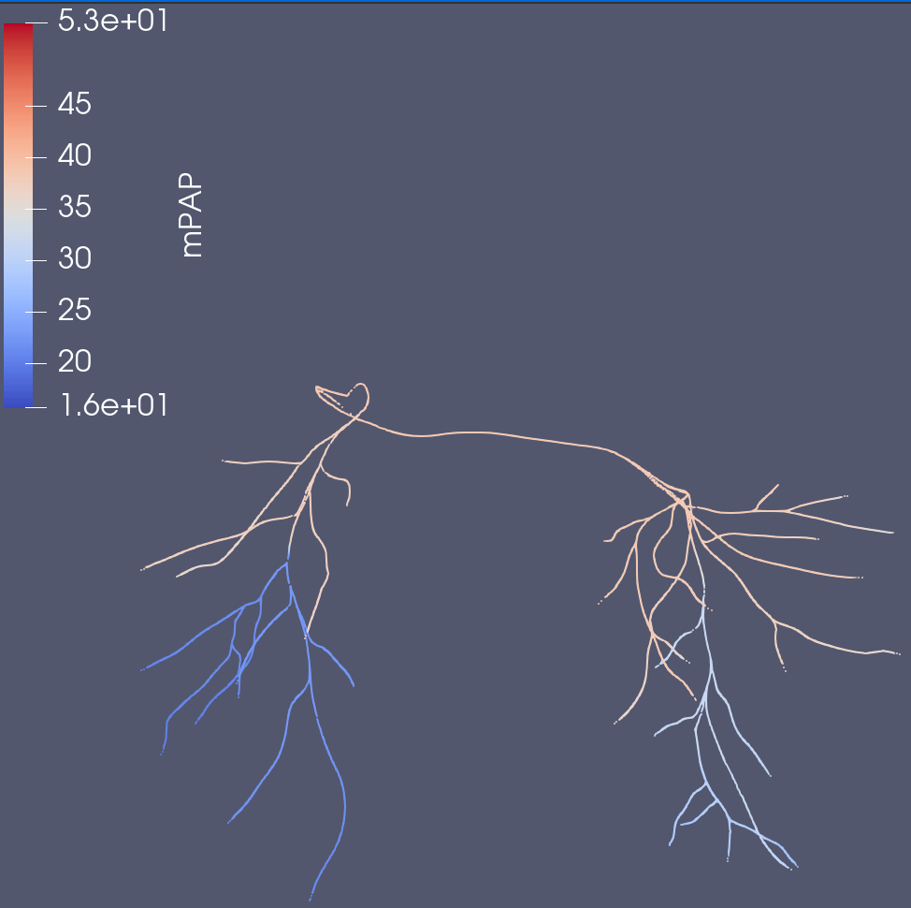
Original
Corresponding Treated
JC Solver

Slide 27
Goal 2 – Next Steps
Temporarily halting progress on stenosis models & focus on Healthy models.
Too many problems/too broad
Healthy models offer a target treatment, as well as guarantee that stenosis is in the vessels
Artificial Stenosis
Attempting to take a 0D stenosis model, computing some sort of generational expected stenosis values, and attempting to map onto a healthy model (can have different versions of artificial stenosis w/ different base 0D stenosis models)
Focusing on JCSolver since results show it is more accurate and provide the pressure drop we need

Slide 28
Goal 3 – Next Steps
Setting up a Neural Network
Inputs:
Vessel Diameter Changes
Outputs:
Tentatively the pressure/flow out after the diameter change
Discuss with a clinician for more precise outputs
Sobol Sampling to achieve a more even/desired distribution when sampling diameter changes
Training on Notre Dame’s CRC computing cluster

Slide 29
Goal 4
Talk to a clinician about probabilities?

